Slide 1
SQL Operators

Slide 2
SQL Arithmetic Operators
Operator Description
+ Add
- Subtract
* Multiply
/ Divide
% Modulo

Slide 3
SQL Comparison Operators
Operator Description
= Equal to
> Greater than
< Less than
>= Greater than or equal to
<= Less than or equal to
<> Not equal to
!= Not equal

Slide 4
SQL Logical Operators
These operators return a Boolean value which can be either a TRUE or FALSE.
Logical operators available in SQL are,
ANY and ALL
AND, OR and NOT
BETWEEN
EXISTS
IN
LIKE
IS NULL

Slide 5
ANY Operator
SQL ANY compares a value of the first table with all values of the second table and returns the row if there is a match with any value.
It has the following syntax:
SELECT column FROM table1 WHERE column OPERATOR ANY ( SELECT column FROM table2);
SELECT * FROM Teachers WHERE age = ANY ( SELECT age FROM Students);

Slide 6
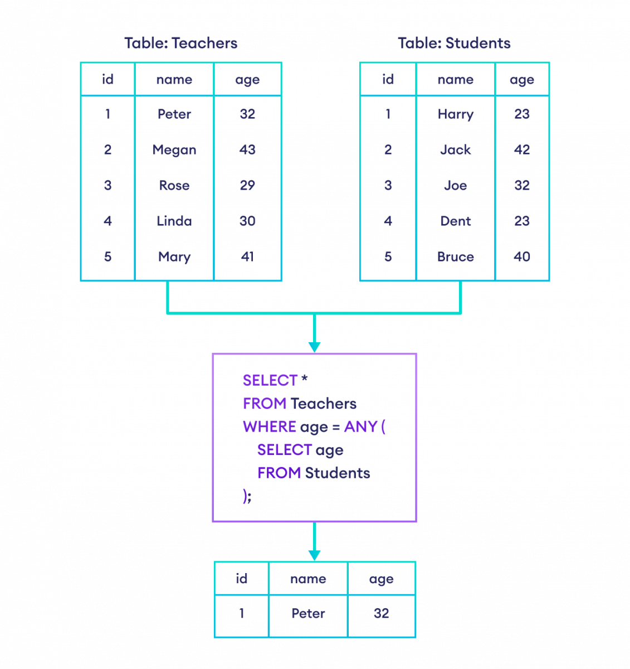

Slide 7
ALL Operator
SQL ALL compares a value of the first table with all values of the second table and returns the row if there is a match with all values.
It has the following syntax:
SELECT column FROM table1 WHERE column OPERATOR ALL ( SELECT column FROM table2);
SELECT * FROM Teachers WHERE age > ALL ( SELECT age FROM Students);

Slide 8
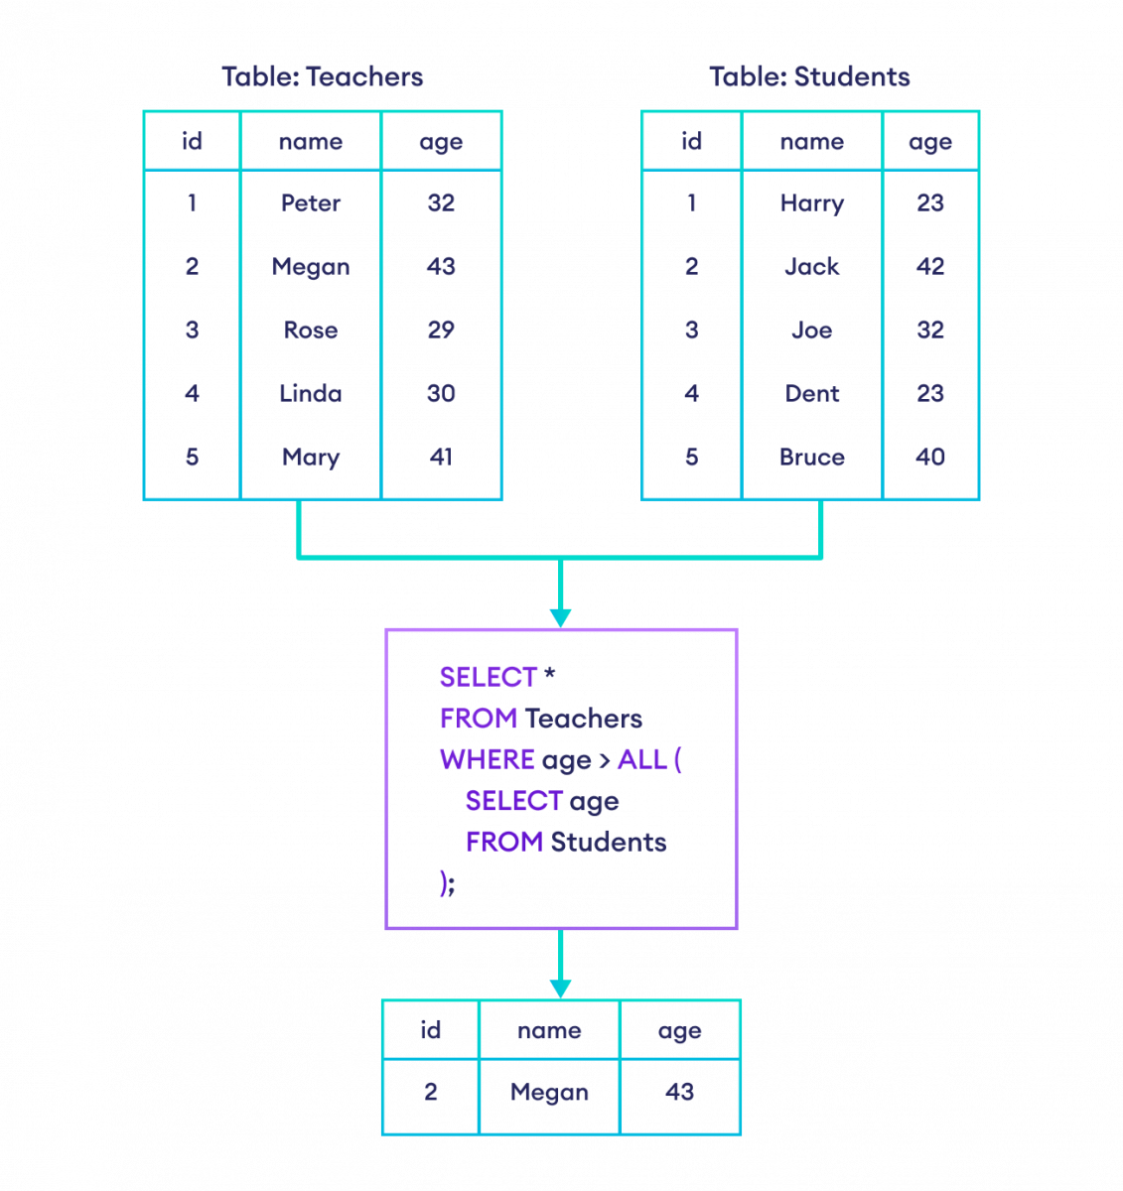

Slide 9
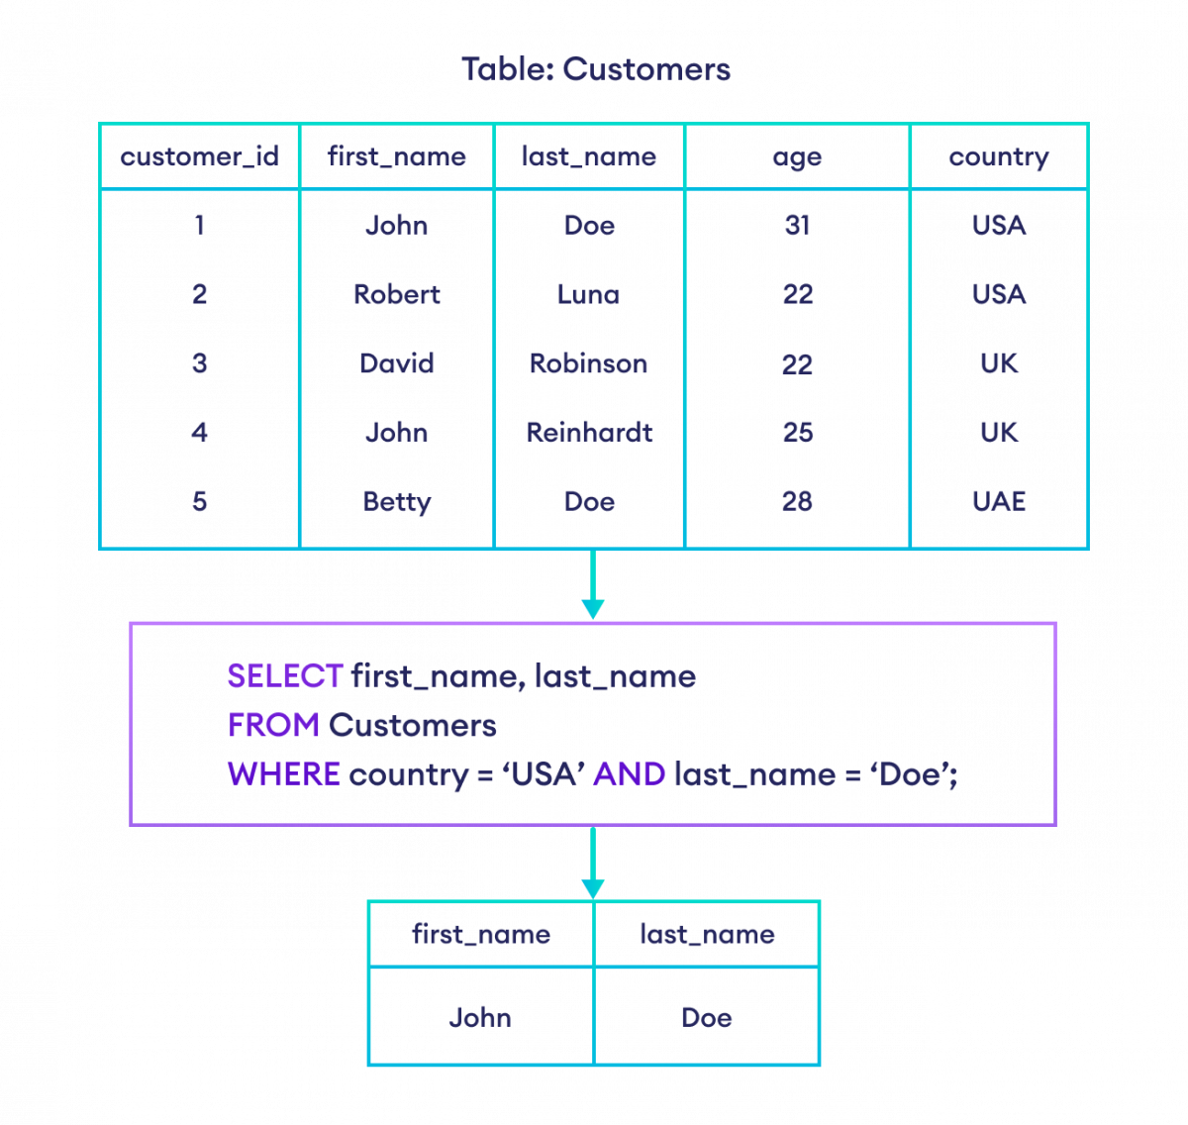
AND Operator
The SQL AND operator selects data if all conditions are TRUE

Slide 10
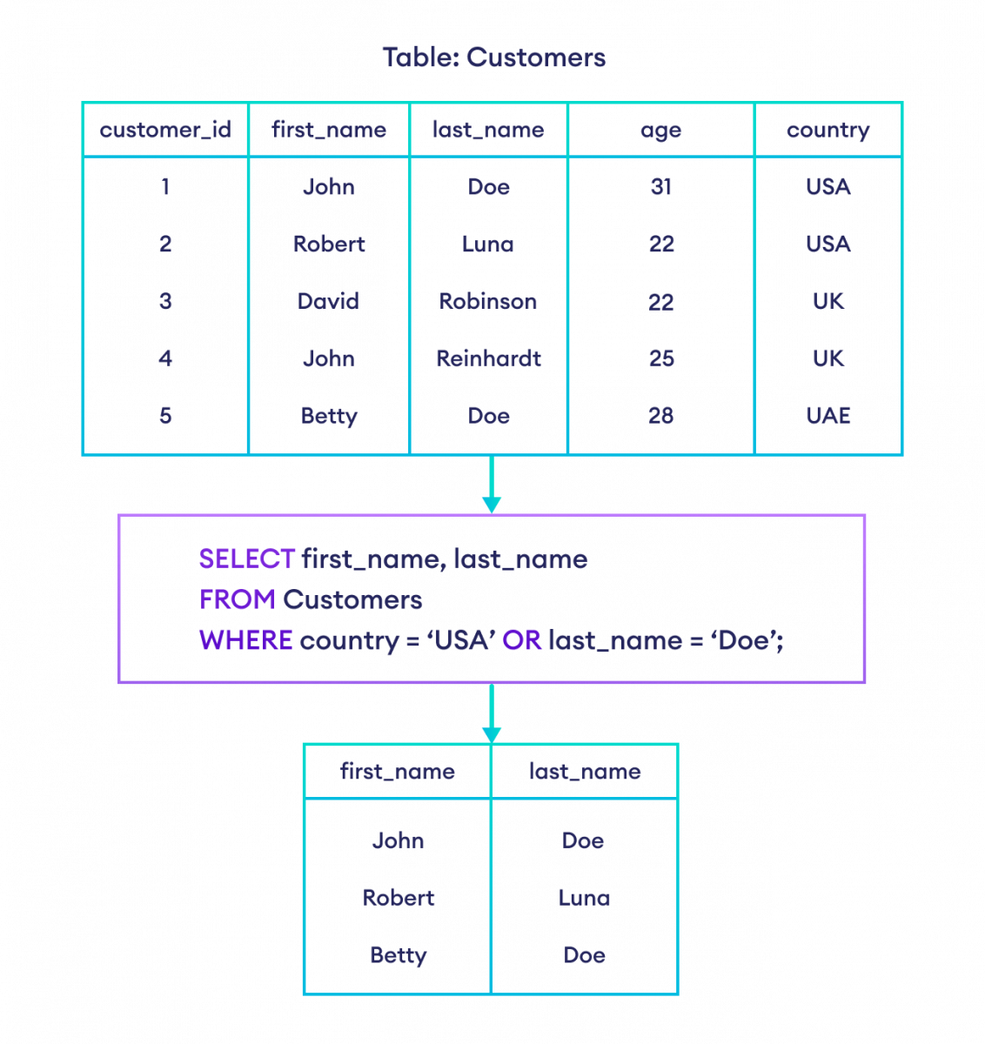
OR Operator
The SQL OR operator selects data if any one condition is TRUE.

Slide 11
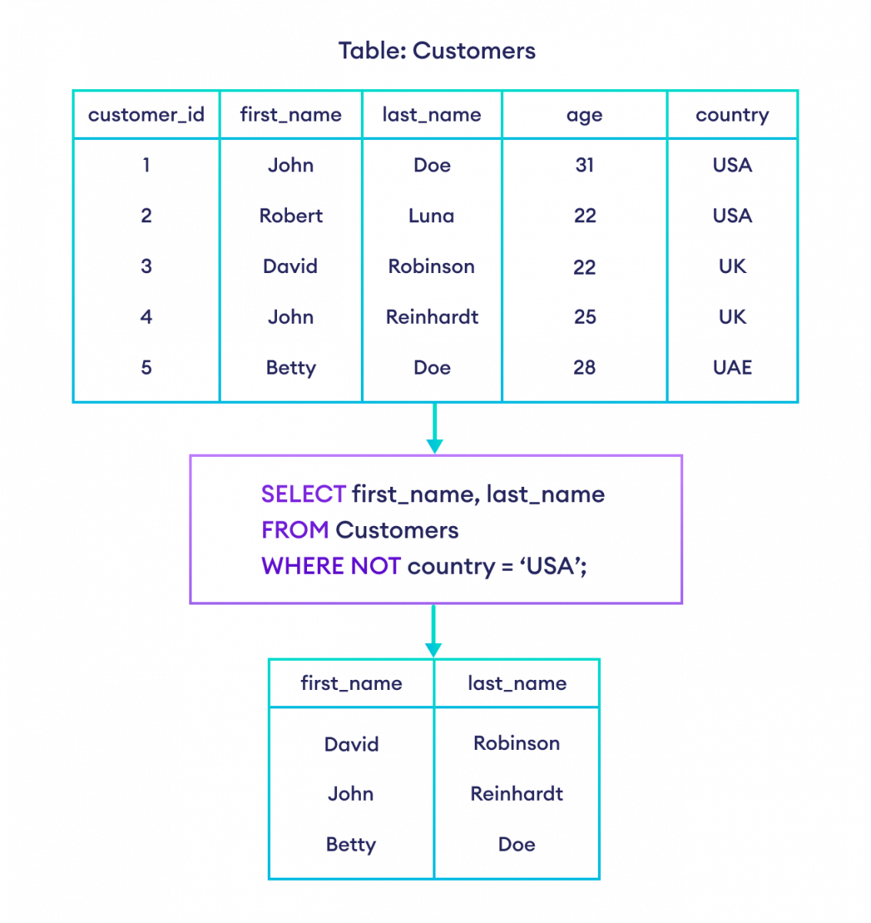
NOT Operator
The SQL NOT operator selects data if the given condition is FALSE.

Slide 12
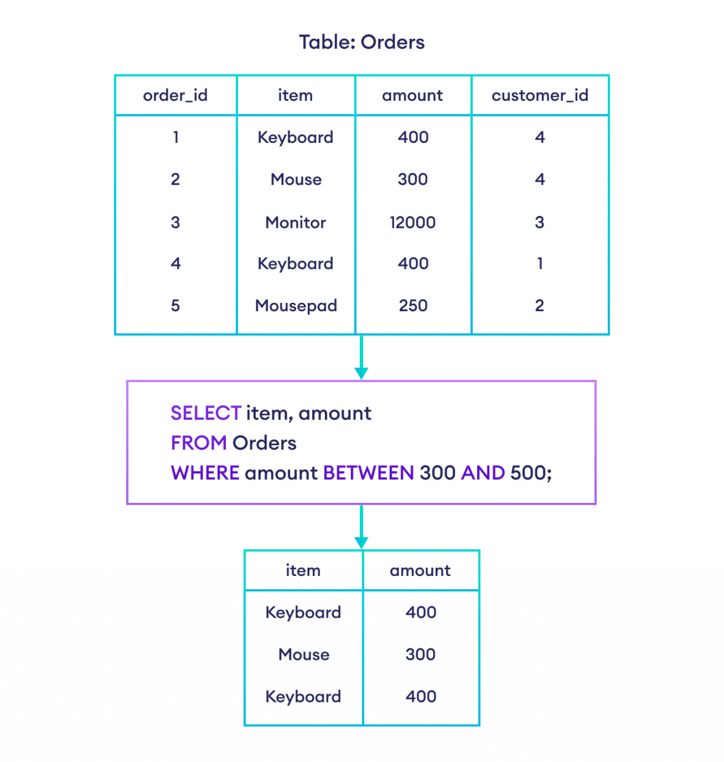
BETWEEN Operator
In SQL, the BETWEEN operator with the WHERE clause selects values within a given range.

Slide 13
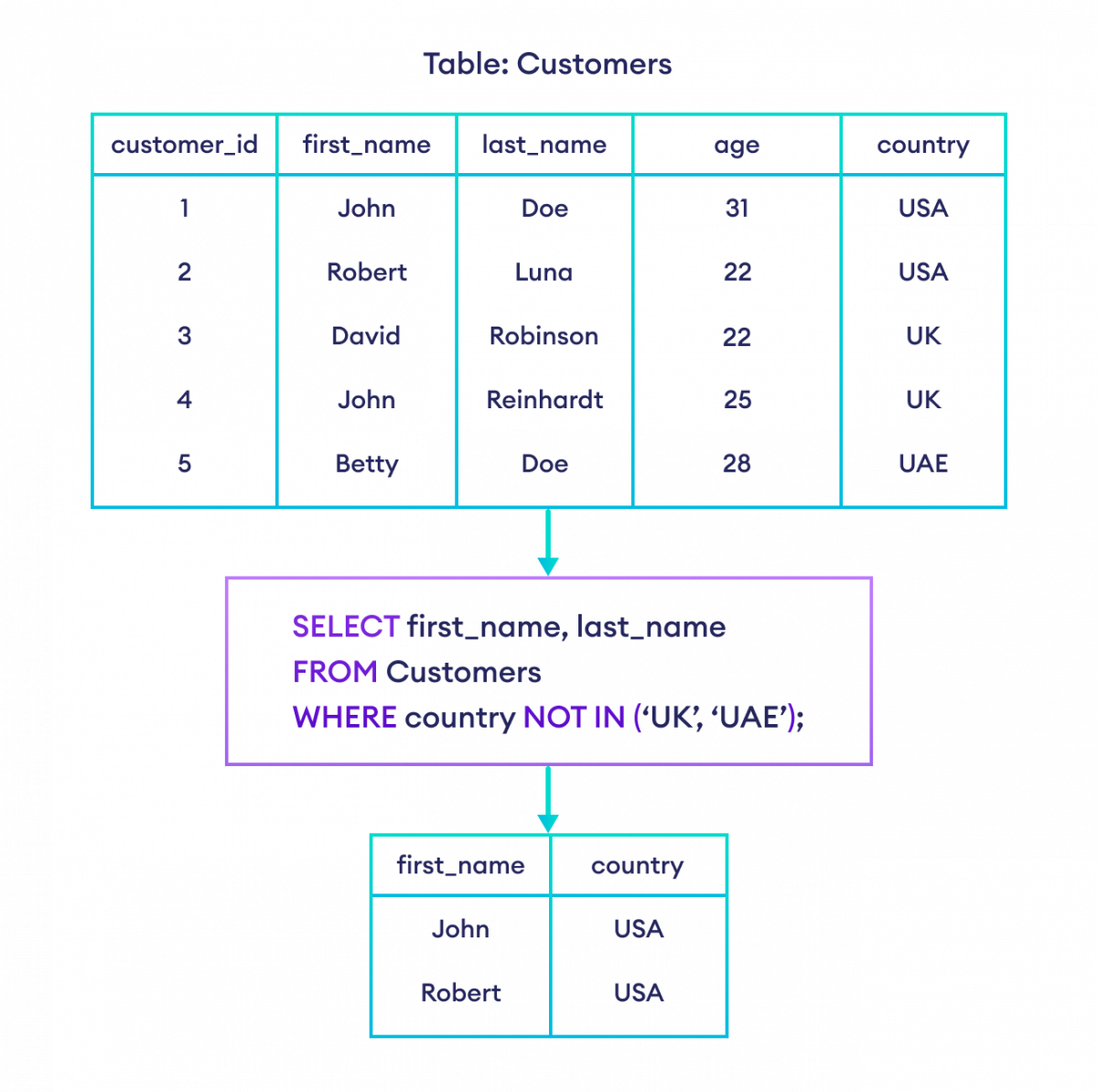
IN Operators
We use the IN operator with the WHERE clause to match values in a list.
SELECT column1, column2 FROM table WHERE column IN (value1, value2, ...);

Slide 14
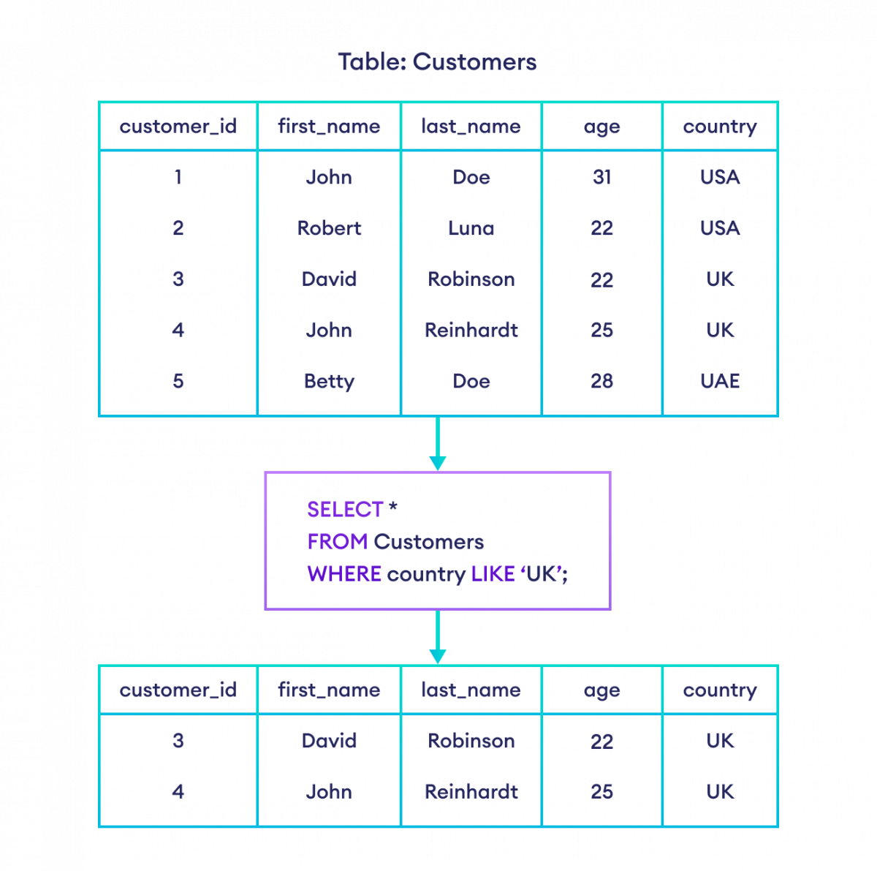
LIKE Operator
We use the SQL LIKE operator with the WHERE clause to get a result set that matches the given string pattern.
Syntax
SELECT column1, column2 FROM table_name WHERE columnN LIKE pattern;
There are two wildcards often used in conjunction with the LIKE operator:
The percent sign % represents zero, one, or multiple characters
The underscore sign _ represents one, single character

Slide 15

SQL LIKE With the % Wildcard
The SQL LIKE query is often used with the % wildcard to match a pattern of a string.

Slide 16
Starts With
To return records that starts with a specific letter or phrase, add the % at the end of the letter or phrase.
Example1
Return all customers that starts with 'La':
SELECT * FROM Customers WHERE CustomerName LIKE 'La%’;
Example2
Return all customers that starts with 'a' or starts with 'b':
SELECT * FROM Customers WHERE CustomerName LIKE 'a%' OR CustomerName LIKE 'b%';

Slide 17
Ends With
To return records that ends with a specific letter or phrase, add the % at the beginning of the letter or phrase.
Example
Return all customers that ends with 'a':
SELECT * FROM Customers WHERE CustomerName LIKE '%a’;
Contains
To return records that contains a specific letter or phrase, add the % both before and after the letter or phrase.
Example
Return all customers that contains the phrase 'or'
SELECT * FROM Customers WHERE CustomerName LIKE '%or%';

Slide 18
Example
Return all customers that starts with "b" and ends with "s":
SELECT * FROM Customers WHERE CustomerName LIKE 'b%s';

Slide 19
Combine Wildcards
Any wildcard, like % and _ , can be used in combination with other wildcards.
Example
Return all customers that starts with "a" and are at least 3 characters in length:
SELECT * FROM Customers WHERE CustomerName LIKE 'a__%';

Slide 20
DISTINCT Statement
The SELECT DISTINCT statement is used to return only distinct (different) values.
Syntax
SELECT DISTINCT column1, column2, ...
FROM table_name;
Example
Select all the different countries from the "Customers" table:
SELECT DISTINCT Country FROM Customers;

Slide 21
ORDER BY
The ORDER BY clause in SQL is a powerful feature used to sort query results in either ascending or descending order based on one or more columns.
The ORDER BY command sorts the result set in ascending order by default. To sort the records in descending order, use the DESC keyword.
The DESC command is used to sort the data returned in descending order.

Slide 22
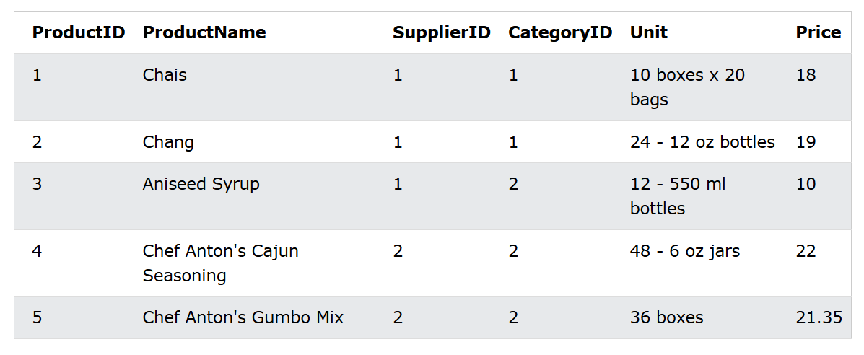
Syntax:
SELECT column1, column2, ...
FROM table_name
ORDER BY column1, column2, ... ASC|DESC;
Example:
1.Sort the products by price:
SELECT * FROM Products
ORDER BY Price;
2.Sort the products from highest to lowest price:
SELECT * FROM Products
ORDER BY Price DESC;

Slide 23
Order Alphabetically
For string values the ORDER BY keyword will order alphabetically:
Example
1. Sort the products alphabetically by ProductName:
SELECT * FROM Products
ORDER BY ProductName;
2. Sort the products by ProductName in reverse order:
SELECT * FROM Products
ORDER BY ProductName DESC;

Slide 24
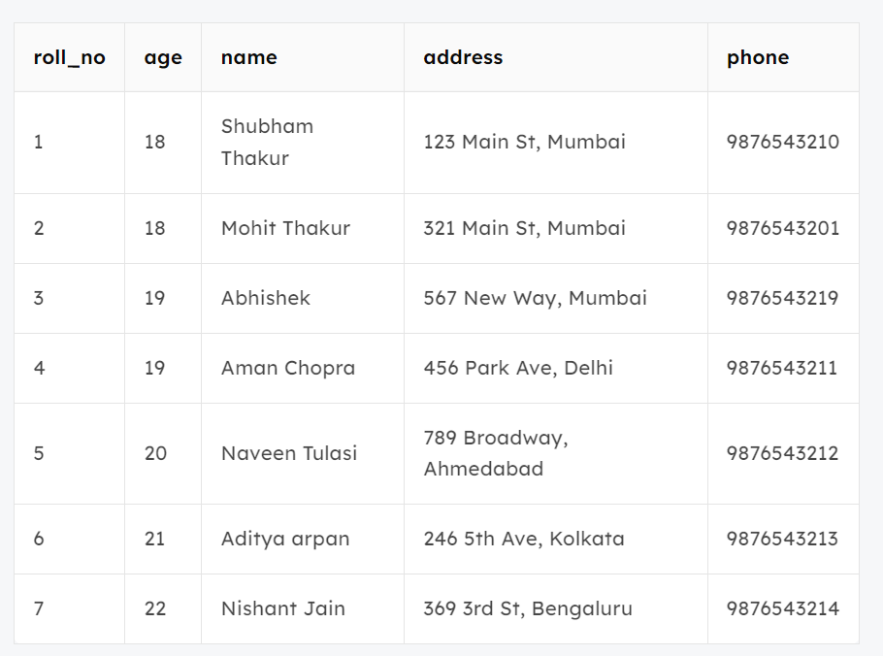
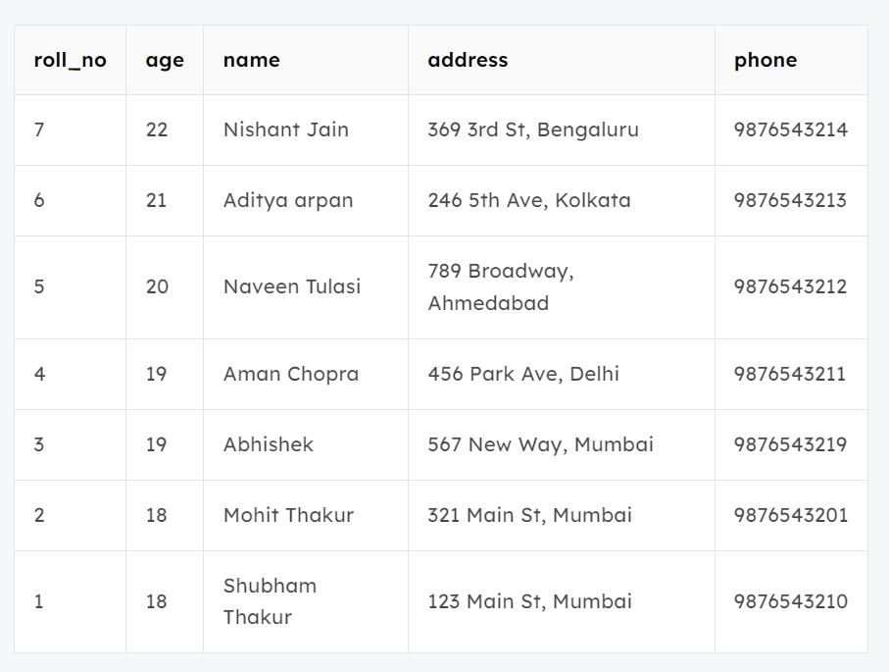
Query:
SELECT * FROM students ORDER BY ROLL_NO DESC;

Slide 25
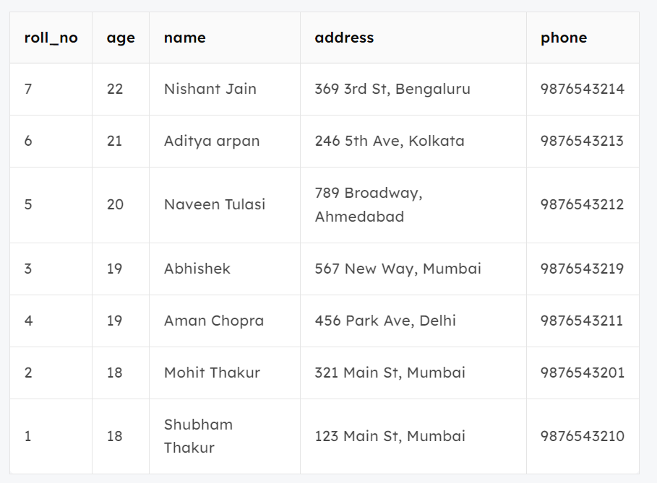
SELECT * FROM students ORDER BY age DESC , name ASC;
Output:
In the above output, we can see that first the result is sorted in descending order according to Age. There are multiple rows of having the same Age. Now, sorting further this result-set according to name will sort the rows with the same Age according to name in ascending order.

Slide 26
DDL (Data Definition Language)
The DDL commands in SQL are:
CREATE: To add a new object to the database.
ALTER: To change the structure of the database.
DROP: To remove an existing object from the database. Check out our guide on how to delete a column in SQL.
TRUNCATE: To remove all records from a table, including the space allocated to store this data.

Slide 27
ALTER command in SQL
The ALTER TABLE statement in SQL is used to modify an existing table structure in a database without losing any data.
It allows you to add, remove, or modify columns, change data types, or apply constraints to improve data integrity and ensure that the table meets evolving business requirements.
It allows for structural changes like adding new columns, modifying existing ones, deleting columns, and renaming columns within a table.
Syntax:
ALTER TABLE table_name
[ADD | DROP | MODIFY] column_name datatype;

Slide 28
1. ADD – To add a new column to the table
The ADD clause is used to add a new column to an existing table. You must specify the name of the new column and its data type.
Query:
ALTER TABLE table_name
ADD column_name datatype;
2. MODIFY/ALTER – To change the data type of an existing column
The MODIFY (or ALTER COLUMN in some databases like SQL Server) clause is used to modify the definition of an existing column, such as changing its data type or size.
Query:
ALTER TABLE table_name
MODIFY COLUMN column_name datatype;

Slide 29
3. DROP – To delete an existing column from the table
The DROP clause allows you to remove a column from a table. Be cautious when using this command as it will permanently remove the column and its data.
Query:
ALTER TABLE table_name
DROP COLUMN column_name;
4. RENAME COLUMN – To rename an existing column
We can rename an existing column using the RENAME COLUMN clause. This allows you to change the name of a column while preserving its data type and content.
Query:
ALTER TABLE table_name
RENAME COLUMN old_name TO new_name;

Slide 30
5. RENAME TO – To rename the table itself
We can rename an entire table using the RENAME TO clause. This changes the name of the table while preserving its structure and data.
ALTER TABLE table_name
RENAME TO new_table_name;

Slide 31
DROP and TRUNCATE in SQL
The DROP and TRUNCATE commands in SQL are used to remove data from a table, but they work differently.
In SQL, the DROP command is used to permanently remove an object from a database, such as a table, database, index, or view. When we DROP a table, both the data and the structure of the object are permanently removed from the database leaving no trace of the object.
1. DROP Table
To delete an entire table, including its data and structure:
Syntax:
DROP TABLE table_name;

Slide 32
TRUNCATE eemoves all rows but preserves the table structure. It deletes only the data, not the table structure.
Is a faster operation compared to the DROP statement.
TRUNCATE TABLE table_name;

Slide 33
Data Manipulation Language (DML) commands
Commands for inserting, deleting, updating, and merging data in Snowflake tables:
INSERT
MERGE
UPDATE
DELETE
TRUNCATE TABLE

Slide 34
SQL INSERT INTO Statement
The INSERT INTO statement in SQL is used to add new rows of data to a table in a database.
There are two main ways to use the INSERT INTO statement by specifying the columns and values explicitly or by inserting values for all columns without specifying them.
There are two primary syntaxes of INSERT INTO statements depending on the requirements. The two syntaxes are:
Syntax 1. Only Values
The first method is to specify only the value of data to be inserted without the column names.
INSERT INTO table_name
VALUES (value1, value2, value);

Slide 35
Syntax 2. Column Names And Values Both
In the second method we will specify both the columns which we want to fill and their corresponding values as shown below:
INSERT INTO table_name (column1, column2, column3)
VALUES ( value1, value2, value);

Slide 36
UPDATE Statement
The UPDATE statement in SQL is used to update the data of an existing table in the database.
We can update single columns as well as multiple columns using the UPDATE statement as per our requirement.
Syntax:
The syntax for SQL UPDATE Statement is :
UPDATE table_name SET column1 = value1, column2 = value2,…
WHERE condition;

Slide 37
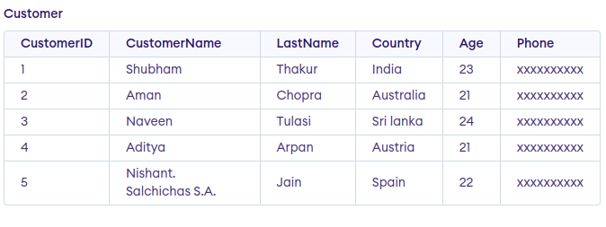
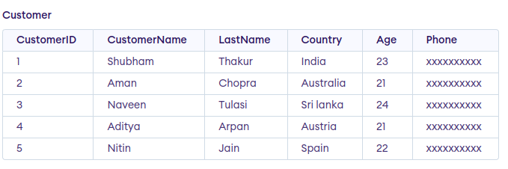
Query:
UPDATE Customer
SET CustomerName = 'Nitin'
WHERE Age = 22;

Slide 38
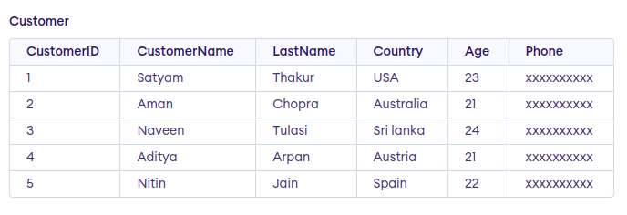
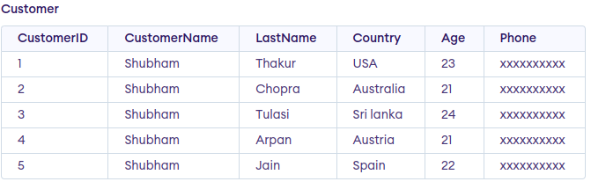
Omitting WHERE Clause in UPDATE Statement
If we omit the WHERE clause from the update query then all of the rows will get updated.
Query:
UPDATE Customer SET CustomerName = 'Shubham';

Slide 39
DELETE Statement
The SQL DELETE statement removes one or more rows from a database table based on a condition specified in the WHERE clause.
Syntax:
DELETE FROM table_name
WHERE some_condition;

Slide 40
Aggregate functions
SQL Aggregate Functions are used to perform calculations on a set of rows and return a single value. They are used to perform mathematical calculations on data. They usually return a single value as output.
They are often used with the GROUP BY clause in SQL to summarize data for each group.
The most commonly used SQL aggregate functions are:
MIN() - returns the smallest value within the selected column
MAX() - returns the largest value within the selected column
COUNT() - returns the number of rows in a set
SUM() - returns the total sum of a numerical column
AVG() - returns the average value of a numerical column

Slide 41
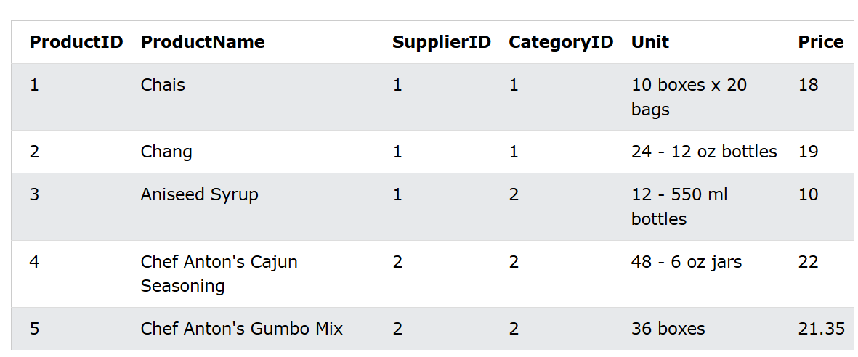

Slide 42
Syntax
SELECT MIN(column_name)
FROM table_name
WHERE condition;
SELECT MAX(column_name)
FROM table_name
WHERE condition;
MIN Example:
Find the lowest price in the Price column:
SELECT MIN(Price)
FROM Products;
MAX Example:
Find the highest price in the Price column:
SELECT MAX(Price)
FROM Products;

Slide 43
Syntax
SELECT COUNT(column_name)
FROM table_name
WHERE condition;
Example
Find the number of products where Price is higher than 20:
SELECT COUNT(ProductID)
FROM Products
WHERE Price > 20;
Example
Find the total number of rows in the Products table:
SELECT COUNT(*)
FROM Products;
Example
Find the number of products where the ProductName is not null:
SELECT COUNT(ProductName)
FROM Products;

Slide 44
Syntax
SELECT SUM(column_name)
FROM table_name
WHERE condition;
Example
Return the sum of the Quantity field for the product with ProductID 11:
SELECT SUM(Quantity)
FROM OrderDetails
WHERE ProductId = 11;
Example
Return the sum of all Quantity fields in the OrderDetails table:
SELECT SUM(Quantity)
FROM OrderDetails;
Example
Use an expression inside the SUM() function:
SELECT SUM(Quantity * 10)
FROM OrderDetails;

Slide 45
Syntax
SELECT AVG(column_name)
FROM table_name
WHERE condition;
Example
Return the average price of products in category 1:
SELECT AVG(Price)
FROM Products
WHERE CategoryID = 1;
Example
Find the average price of all products:
SELECT AVG(Price)
FROM Products;
Example
Return all products with a higher price than the average price:
SELECT * FROM Products
WHERE price > (SELECT AVG(price) FROM Products);

Slide 46
GROUP BY Clause
The GROUP BY statement in SQL is used for organizing and summarizing data based on identical values in specified columns.
By using the GROUP BY clause, users can apply aggregate functions like SUM, COUNT, AVG, MIN, and MAX to each group, making it easier to perform detailed data analysis.
The GROUP BY statement in SQL is used to arrange identical data into groups based on specified columns.
If a particular column has the same values in multiple rows, the GROUP BY clause will group these rows together.
Key Points About GROUP BY:
GROUP BY clause is used with the SELECT statement.
In the query, the GROUP BY clause is placed after the WHERE clause.
In the query, the GROUP BY clause is placed before the ORDER BY clause if used.
In the query, the Group BY clause is placed before the Having clause.
Place condition in the having clause.

Slide 47
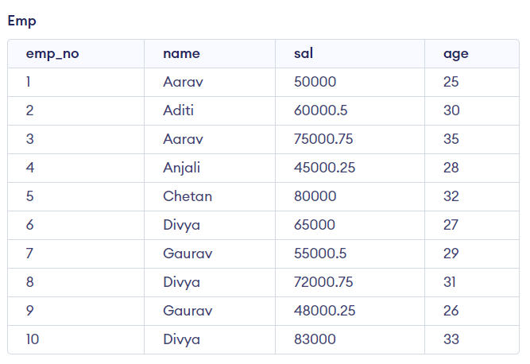
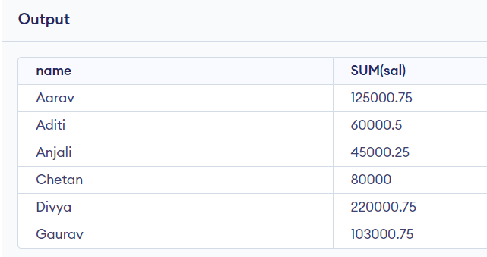
Syntax:
SELECT column1, function_name(column2)
FROM table_name
GROUP BY column1, column2
Example 1 : Group By Single Column
Query:
SELECT name, SUM(sal) FROM emp
GROUP BY name;

Slide 48
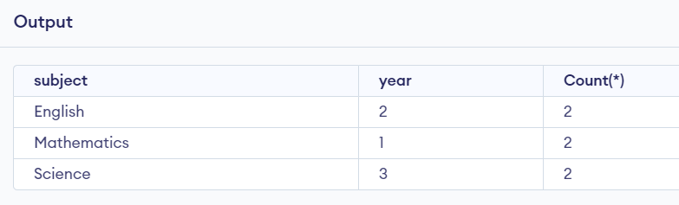
Example 2 : Group By Multiple Columns
Group by multiple columns is say, for example, GROUP BY column1, column2. This means placing all the rows with the same values of columns column 1 and column 2 in one group. Consider the below query:
Query:
SELECT SUBJECT, YEAR, Count(*)
FROM Student
GROUP BY SUBJECT, YEAR;
As we can see in the above output the students with both the same SUBJECT and YEAR are placed in the same group. And those whose only SUBJECT is the same but not YEAR belong to different groups. So here we have grouped the table according to two columns or more than one column. The Grouped subject and years are (English,2) , (Mathematics,1) and (Science,3). The above-mentioned all groups and years are repeated twice.

Slide 49
SQL HAVING Clause
The HAVING clause in SQL is used to filter query results based on aggregate functions. Unlike the WHERE clause, which filters individual rows before grouping, the HAVING clause filters groups of data after aggregation.
The HAVING clause is used to filter the result of the GROUP BY statement based on the specified conditions.
It allows filtering grouped data using Boolean conditions (AND, OR).
It was introduced because the WHERE clause cannot be used with aggregate functions.

Slide 50
Syntax:
SELECT column_name, AGGREGATE_FUNCTION(column_name)
FROM table_name
GROUP BY column_name
HAVING condition;

Slide 51
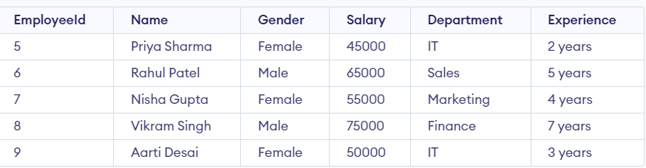
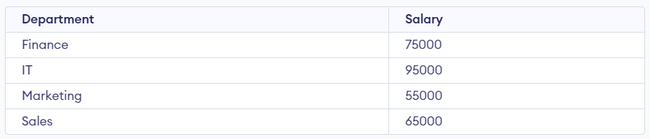
Query:
SELECT Department, sum(Salary) as Salary
FROM Employee
GROUP BY department;

Slide 52
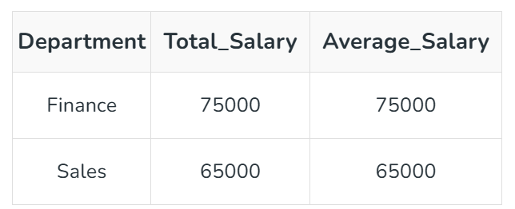
Example 2: Using HAVING with Multiple Conditions
If we want to find the departments where the total salary is greater than or equal to $50,000, and the average salary is greater than $55,000. We can use the HAVING clause to apply both conditions.
Query
SELECT Department, SUM(Salary) AS Total_Salary, AVG(Salary) AS Average_Salary FROM Employee
GROUP BY Department
HAVING SUM(Salary) >= 50000 AND AVG(Salary) > 55000;

Slide 53
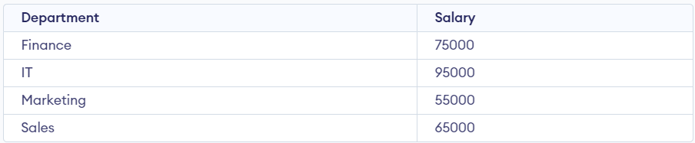
Example: Now if we need to display the departments where the sum of salaries is 50,000 or more. In this condition, we will use the HAVING Clause.
Query:
SELECT Department, sum(Salary) as Salary
FROM Employee
GROUP BY department
HAVING SUM(Salary) >= 50000;

Slide 54
Scalar Functions
Scalar functions are also used to return a single value after performing data operation.
Scalar functions are used to perform operations on individual values in a column and return a single value for each row in the result set.
These functions can be used to manipulate strings, numbers, and dates, among other data types.
The most common Scalar Functions are:
UCASE() ROUND()
LCASE() NOW()
MID() FORMAT()
LENGTH()

Slide 55
1. UCASE()
The UCASE() or the upper case function changes the case of the string to uppercase. An individual string or a column can be passed as the parameter to the function.
Syntax:
SELECT UCASE(string);
OR
SELECT UCASE(column_name) FROM table_name;
Example:
SELECT UCASE('tree');
Output: TREE
Using UCASE(), the case of the string has been changed to uppercase.
tree -> TREE

Slide 56
2. LCASE()
The LCASE() or the lowercase function changes the case of the string to lowercase. Like UCASE(), any number of strings can be passed as a parameter to the LCASE() function.
Syntax:
SELECT LCASE(string);
OR
SELECT LCASE(column_name) FROM table_name;
Example:
SELECT LCASE('HeLLOWorld');
Output: helloworld
Explaination: Here, the case of the letters is changed to lowercase using the LCASE() function.
HeLLOWorld -> helloworld

Slide 57
3. MID()
The MID() function is used to extract substrings from the string passed as a parameter or from the table's column, which is of string datatype.
Syntax:
SELECT MID(string, start, length);
OR
SELECT MID(column_name, start, length) FROM table_name;
Where, string/column_name is full of the string from which the substrings need to be extracted. start refers to the integer value that denotes the start position, starting from 1. length is the integer value that denotes the length of the substring to be extracted from the main string starting from start. Length is an optional parameter. If not stated, the whole string after the start position will be extracted as result.

Slide 58
Example:
SELECT MID('Worlds of Wonder', 11, 6);
Output: Wonder
Explanation: In the above example, a substring has been extracted from the string.
start = 11, means the extraction would start from 11th position,i.e., W length = 6, 6 letters would be extracted out.
As a result, 'Wonder' is returned.

Slide 59
4. LENGTH()
The LENGTH() function returns the length of the string passed as a parameter.
Syntax:
SELECT LENGTH(string);
OR
SELECT LENGTH(column_name) FROM table_name;
Example:
SELECT LENGTH('sunshine');
Output: 8
using LENGTH(), the length of the string provided is returned. Here, the string is 'sunshine', 8 letter word. Thereby, 8 is returned.

Slide 60
5. ROUND()
The ROUND() function is used to round off the numeric values to the specified decimal value.
Syntax:
SELECT ROUND(numeric_value, Decimal);
OR
SELECT ROUND(column_name, Decimal) FROM table_name;
Where Decimal is the number of decimals that need to be fetched.
Example:
SELECT ROUND(3245.8762, 3);
Output: 3245.876
The ROUND() function has rounded off the value given to 3 decimal places.

Slide 61
6. NOW()
The NOW() function is used to get the current system's date and time.
Syntax:
SELECT NOW();
OR
SELECT NOW() FROM table_name;
Example:
SELECT NOW();
Output: 2022-02-12 21:41:48
Here, the NOW() function has simply returned the current date and time.

Slide 62
7. FORMAT()
The FORMAT() function is used to modify the display of the column values. There can be different formats that we can use.
Syntax:
SELECT FORMAT(value/string, FormatRequired );
OR
SELECT FORMAT(column_name, FormatRequired ) FROM table_name;
Where, FormatRequired is the format in which the value/string will be displayed.
Example:
SELECT FORMAT( 137/3, 2 );
Output: 45.67
FORMAT() function has returned the value rounded off 2 decimal places after dividing by 3.

Slide 63
String functions
SQL String Functions are powerful tools that allow us to manipulate, format, and extract specific parts of text data in our database. These functions are essential for tasks like cleaning up data, comparing strings, and combining text fields.
Common SQL String Functions
String functions are used to perform an operation on input string and return an output string. Following are the string functions defined in SQL:
1. CONCAT(): Concatenate Strings
The CONCAT() function is used to concatenate (combine) two or more strings into one string. It is useful when we want to merge fields like first and last names into a full name.
Query:
SELECT CONCAT('John', ' ', 'Doe') AS FullName;
Output: John Doe

Slide 64
2. CHAR_LENGTH() / CHARACTER_LENGTH(): Find String Length
The CHAR_LENGTH() or LENGTH() function returns the length of a string in characters. It’s essential for validating or manipulating text data, especially when you need to know how many characters a string contains.
Query:
SELECT CHAR_LENGTH('Hello') AS StringLength;
Output: 5

Slide 65
3. UPPER() and LOWER(): Convert Text Case
These functions convert the text to uppercase or lowercase, respectively. They are useful for normalizing the case of text in a database.
Query:
SELECT UPPER('hello') AS UpperCase;
SELECT LOWER('HELLO') AS LowerCase;
Output:
HELLO
hello

Slide 66
4. LENGTH(): Length of String in Bytes
LENGTH() returns the length of a string in bytes. This can be useful for working with multi-byte character sets.
Query:
SELECT LENGTH('Hello');
Output: 5
Example: Find all the students’ names having length greater than 6 characters.
SELECT student_name
FROM students
WHERE LENGTH(student_name) > 6;

Slide 67
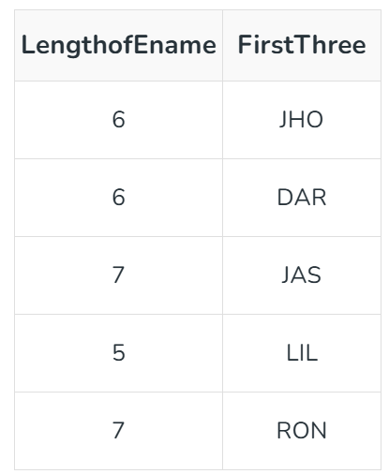
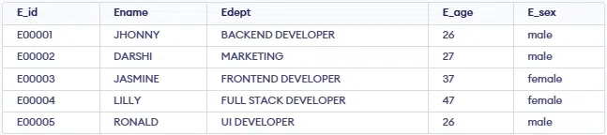
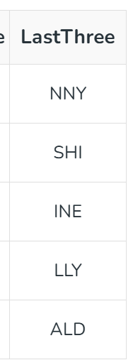
Example: Display the Length and First 3 Characters of Ename Column?
Query:
SELECT LEN(Ename) AS LengthofEname,
LEFT(Ename,3) AS FirstThree FROM Emp;
Example: Display the Last 3 Characters of Ename Column?
Query:
SELECT RIGHT(Ename,3) AS LastThree FROM Emp;

Slide 68
5. REPLACE(): Replace Substring in String
The REPLACE() function replaces occurrences of a substring within a string with another substring. This is useful for cleaning up data, such as replacing invalid characters or formatting errors.
Query:
SELECT REPLACE('Hello World', 'World', 'SQL') AS UpdatedString;
Output: Hello SQL

Slide 69
6. SUBSTRING() / SUBSTR(): Extract Part of a String
The SUBSTRING() (or SUBSTR()) function is used to extract a substring from a string, starting from a specified position. It is especially useful when we need to extract a specific part of a string, like extracting the domain from an email address.
Syntax: SUBSTRING(string, start_position, length):
Extracts a portion of a string, starting at the specified position and with a specified length.
Query:
SELECT SUBSTRING('Hello World', 1, 5) AS SubStringExample;
Output: Hello

Slide 70
7. LEFT() and RIGHT(): Extract Substring from Left or Right
The LEFT() and RIGHT() functions allow you to extract a specified number of characters from the left or right side of a string, respectively. It is used for truncating strings for display.
Query:
SELECT LEFT('Hello World', 5) AS LeftString;
SELECT RIGHT('Hello World', 5) AS RightString;
Output:
Hello
World

Slide 71
8. INSTR(): Find Position of Substring
The INSTR() function is used to find the position of the first occurrence of a substring within a string. It returns the position (1-based index) of the substring. If the substring is not found, it returns 0. This function is particularly useful for locating specific characters or substrings in text data.
Query:
SELECT INSTR('Hello World', 'World') AS SubstringPosition;
Output: 7

Slide 72
10. REVERSE(): Reverse the String
The REVERSE() function reverses the characters in a string. It’s useful in situations where we need to process data backward, such as for password validation or certain pattern matching.
Query:
SELECT REVERSE('Hello') AS ReversedString;
Output: olleH

Slide 73
Numeric Functions
SQL Numeric Functions are essential tools for performing mathematical and arithmetic operations on numeric data. These functions allow you to manipulate numbers, perform calculations, and aggregate data for reporting and analysis purposes.
1. ABS() – Absolute Value
The ABS() function returns the absolute value of a number, which is the number without its sign (i.e., it converts negative numbers to positive).
Syntax:
SELECT ABS(number);
Example:
SELECT ABS(-25);
Output: 25

Slide 74
2. CEIL() or CEILING() – Round Number Up
The CEIL() (or CEILING()) function rounds a number up to the nearest integer, regardless of whether the decimal part is greater than or less than 0.5.
Syntax:
SELECT CEIL(number);
Example:
SELECT CEIL(12.34);
Output: 13

Slide 75
3. FLOOR() – Round Number Down
The FLOOR() function rounds a number down to the nearest integer, ignoring the decimal part.
Syntax:
SELECT FLOOR(number);
Example:
SELECT FLOOR(12.98);
Output: 12

Slide 76
4. ROUND() – Round a Number to a Specified Decimal Place
The ROUND() function rounds a number to a specified number of decimal places. It is very useful for financial calculations or whenever precise rounding is necessary.
Syntax:
SELECT ROUND(number, decimal_places);
Example:
SELECT ROUND(15.6789, 2);
Output: 15.68

Slide 77
5. TRUNCATE() – Remove Decimal Places
The TRUNCATE() function is used to remove the decimal portion of a number without rounding. It truncates the number to the specified number of decimal places.
Syntax:
SELECT TRUNCATE(number, decimal_places);
Example:
SELECT TRUNCATE(12.98765, 2);
Output: 12.98

Slide 78
6. MOD() – Modulo or Remainder
The MOD() function returns the remainder of a division operation (i.e., it computes the modulus). This function is useful for tasks like determining even/odd numbers or finding remainders in mathematical operations.
Syntax:
SELECT MOD(dividend, divisor);
Example:
SELECT MOD(10, 3);
Output: 1

Slide 79
7. POWER() – Raise a Number to the Power of Another
The POWER() function is used to raise a number to the power of another number. It is often used in mathematical calculations like compound interest or growth rate.
Syntax:
SELECT POWER(base, exponent);
Example:
SELECT POWER(2, 3);
Output: 8

Slide 80
8. SQRT() – Square Root
The SQRT() function returns the square root of a number. This is useful for mathematical calculations involving geometry or statistical analysis.
Syntax:
SELECT SQRT(number);
Example:
SELECT SQRT(16);
Output: 4

Slide 81
9. LOG() – Logarithm
The LOG() function returns the natural logarithm (base e) of a number. You can also use LOG(base, number) to calculate the logarithm of a number with a custom base.
Syntax:
SELECT LOG(number);
SELECT LOG(base, number);
Example:
SELECT LOG(100);
Output: 4.605170186

Slide 82
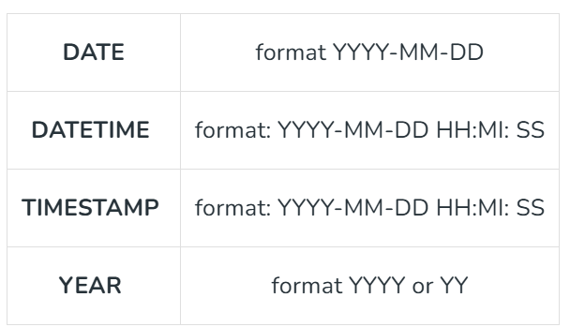
SQL Date and Time Functions
Handling date and time data in SQL is essential for many database operations. SQL provides a variety of date and time functions that help users work with date values, perform calculations, and format them as needed.

Slide 83
SQL Date Functions
1. NOW()
The NOW() function retrieves the current date and time in YYYY-MM-DD HH:MI:SS format.
Query:
SELECT NOW();
2. CURDATE()
CURDATE() returns the current date in YYYY-MM-DD format, without the time part.
Query:
SELECT CURDATE();

Slide 84
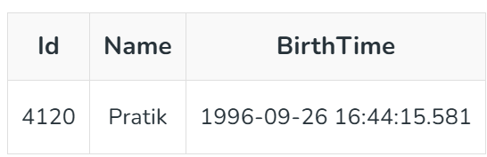
3. CURTIME()
The CURTIME() function returns the current time in HH:MI:SS format, excluding the date.
Query:
SELECT CURTIME();
4. DATE()
Extracts the date part of a date or date/time expression. Example: For the below table named ‘Test’

Slide 85
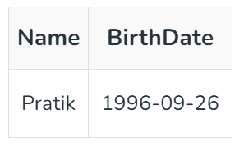
Query:
SELECT Name, DATE(BirthTime)
AS BirthDate FROM Test;
Output:

Slide 86
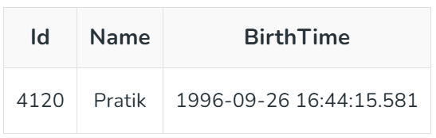
5. EXTRACT()
The EXTRACT() function retrieves a specific part of a DATE, DATETIME, or TIMESTAMP value, such as the day, year, or second.
Syntax:
EXTRACT(unit FROM date);
Several units can be considered but only some are used such as MICROSECOND, SECOND, MINUTE, HOUR, DAY, WEEK, MONTH, QUARTER, YEAR, etc. And ‘date’ is a valid date expression. Example: For the below table named ‘Test’.

Slide 87
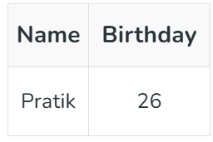
Query:
SELECT Name, Extract(DAY FROM BirthTime) AS BirthDay FROM Test;
Output:

